Slide 1
Hanwash Indicator Performance

Slide 2
H.I.P
Accessibility of the platform

Slide 3
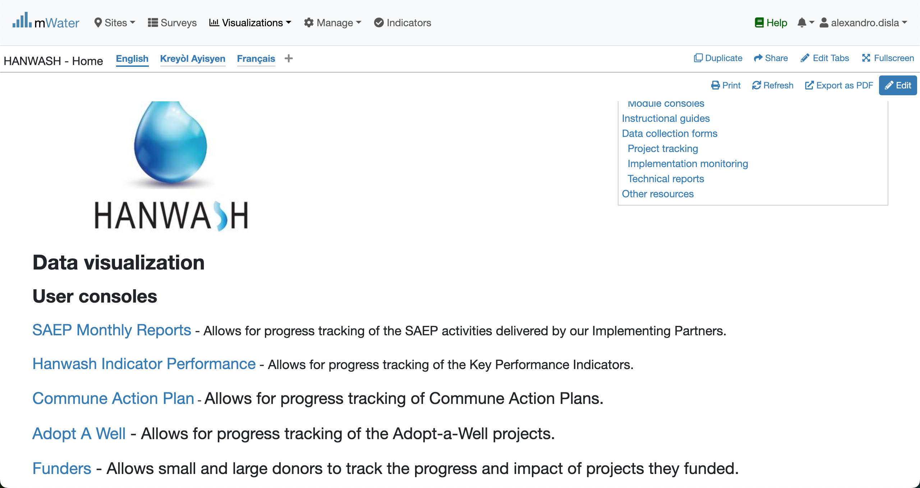
Hanwash HOME
URL LINK : http://go.mwater.co/hanwash

Slide 4
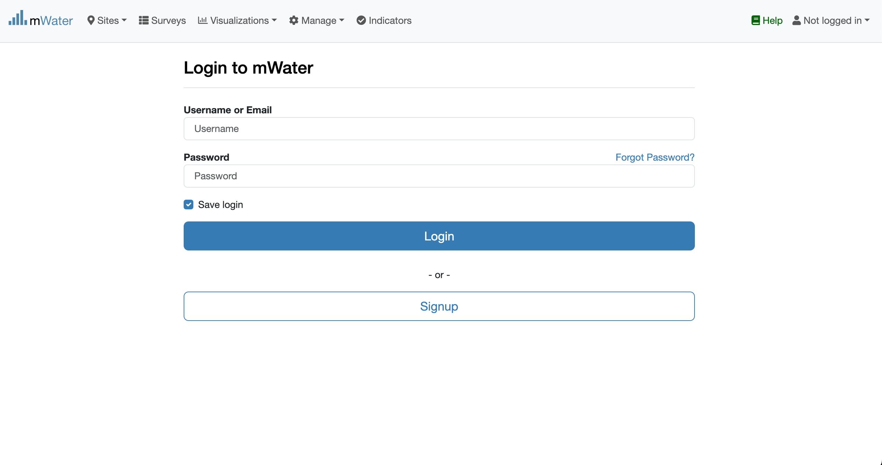
Access The HIP & Login process
Click on the HIP url link
Log status indicator
Please enter your Credentials

Slide 5

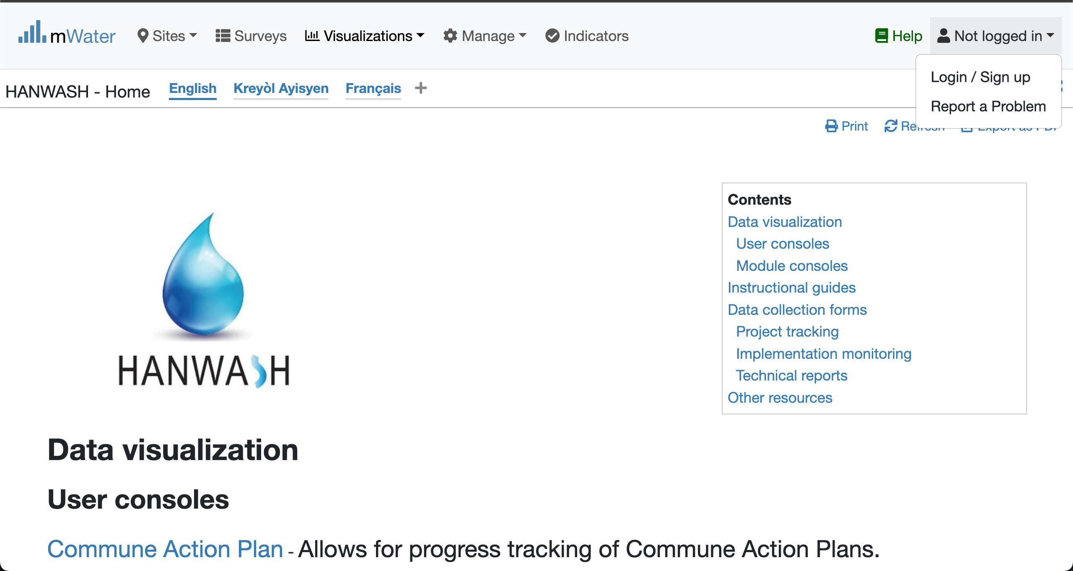


Login Process (2nd scenario)
Click to Login or Signup
Please Click on this selection box
Please enter your Credentials

Slide 6
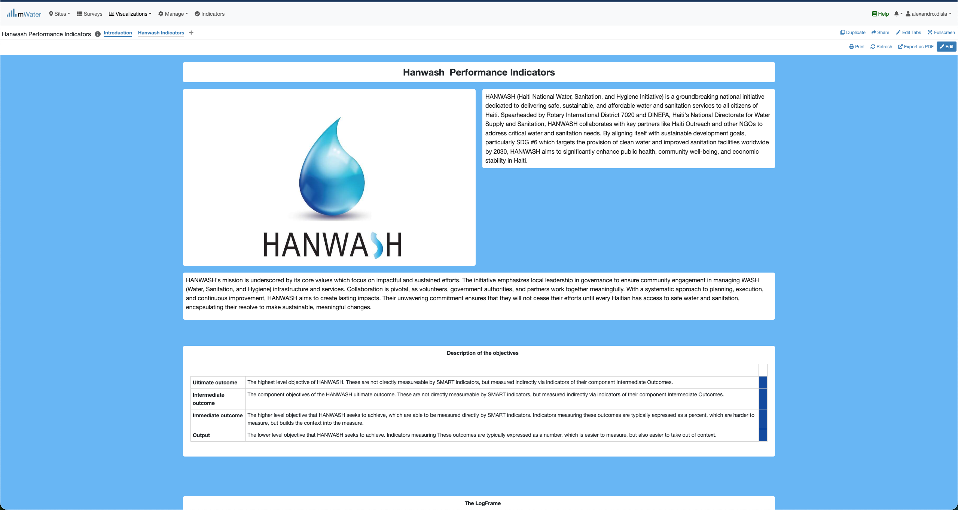
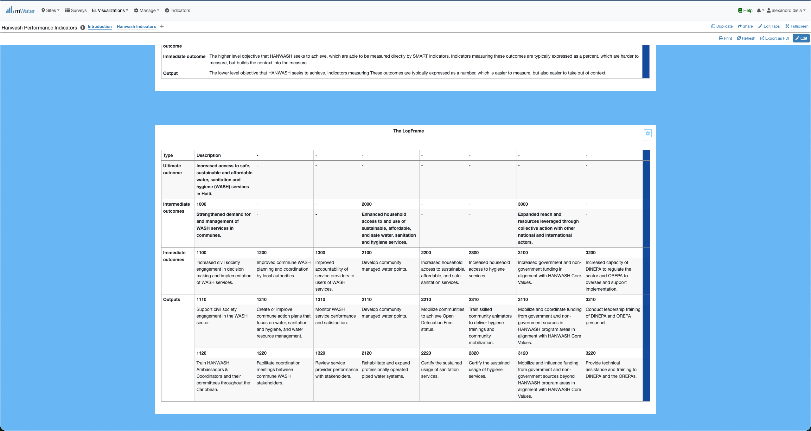
HIP Console overview

Slide 7
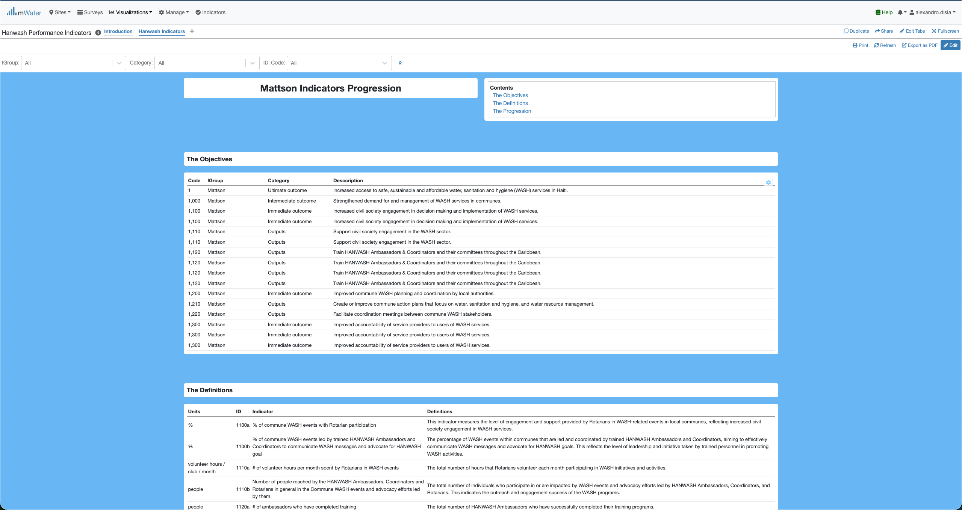
HIP Console overview

Slide 8
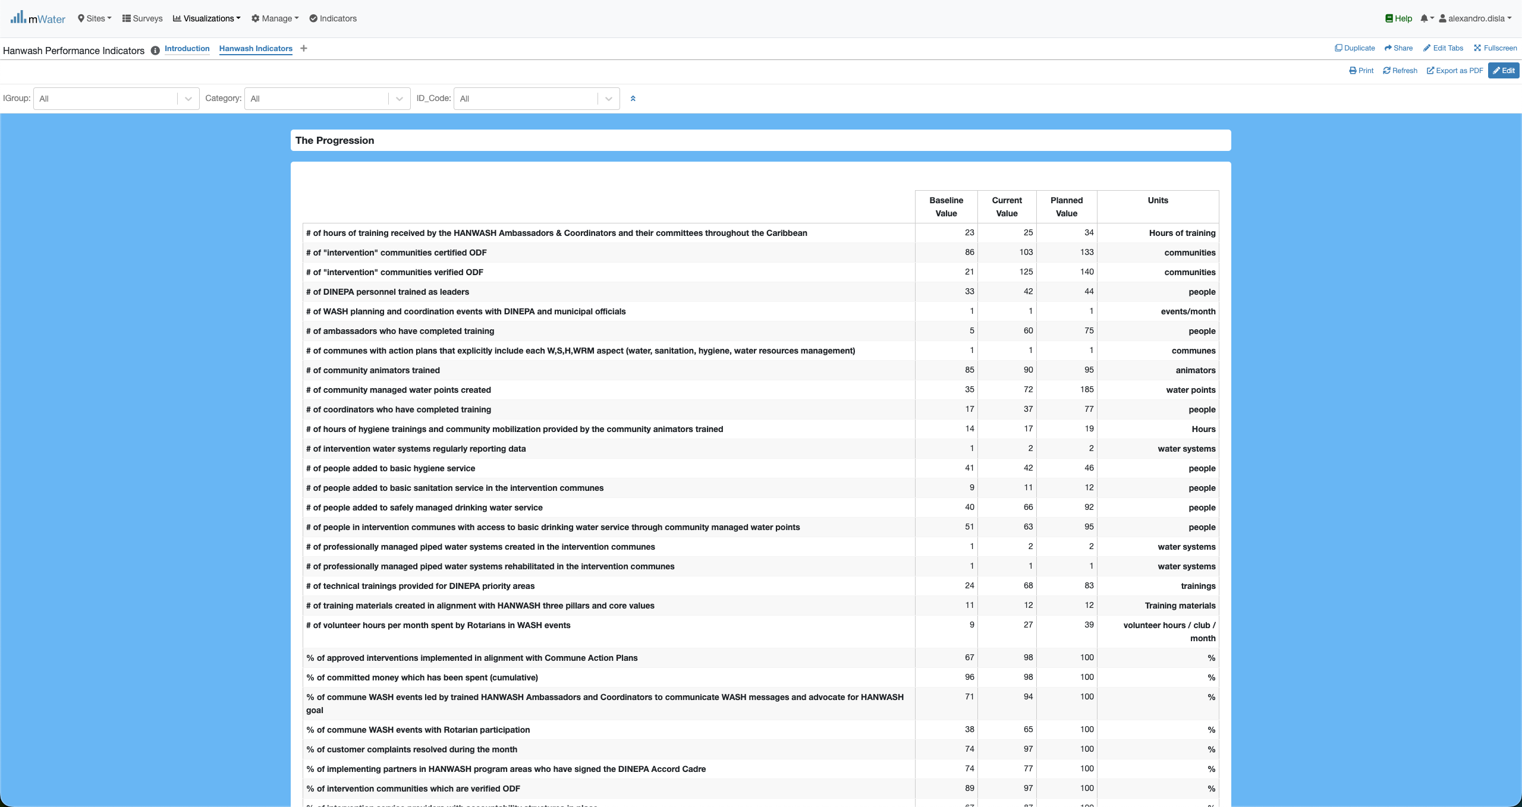
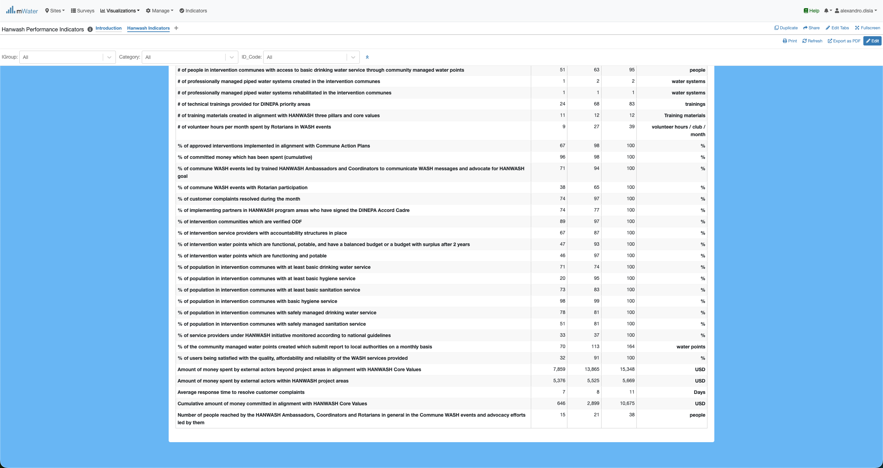
HIP Console overview

Slide 9
Functionalities
Functionalities available in the console

Slide 10
The introduction page
Introduction

Slide 11
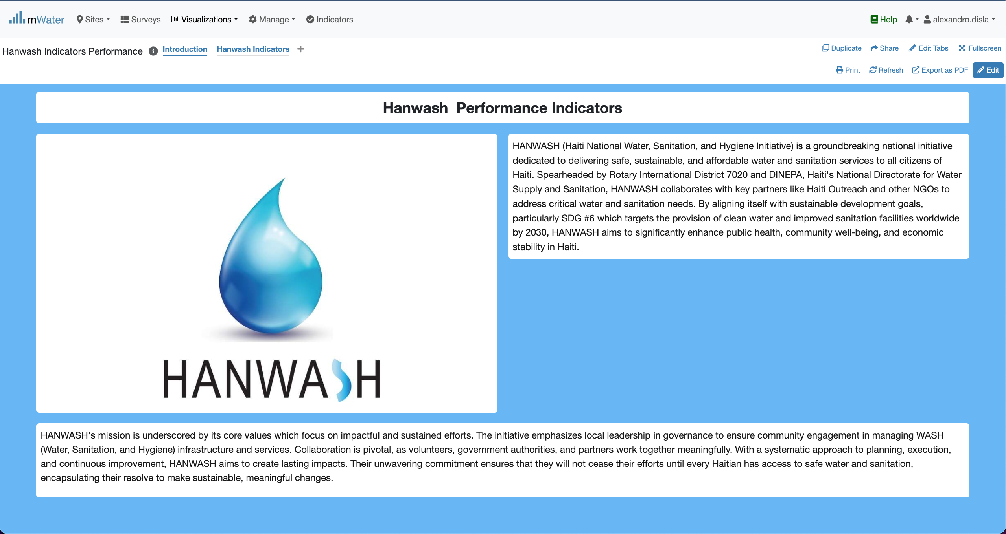
Introduction
Hanwash mission
The active page indicator
Hanwash core values

Slide 12
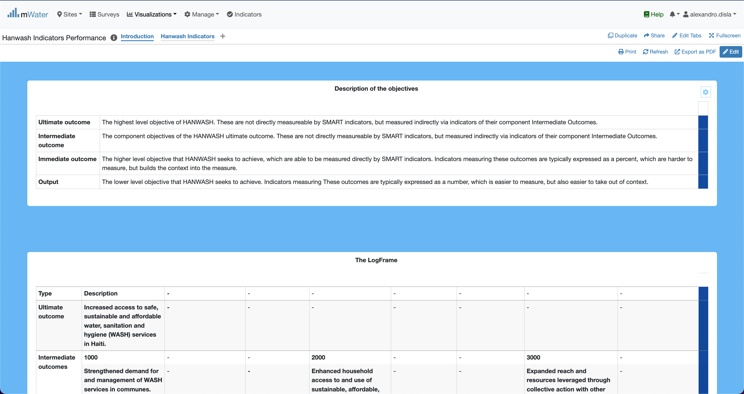
Introduction
This section give a description for each outcome tied to the objectives of the organisation.

Slide 13
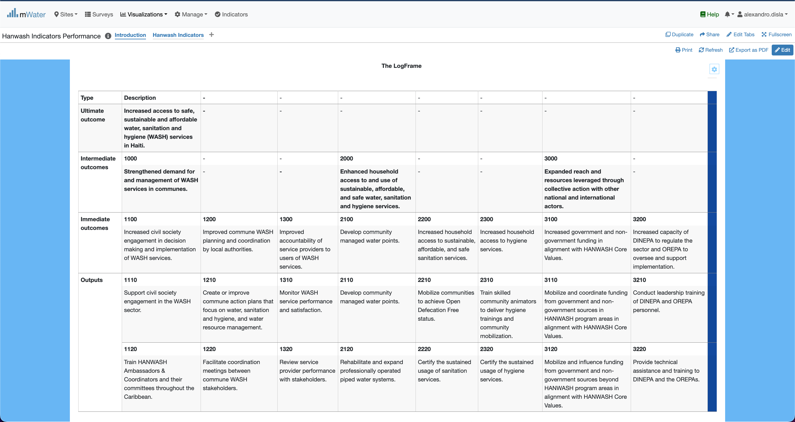
Introduction
The key feature of merge and center is missing from the platform. We have place these yellow box to showcase this.

Slide 14
The Main page
Hanwash Indicators

Slide 15
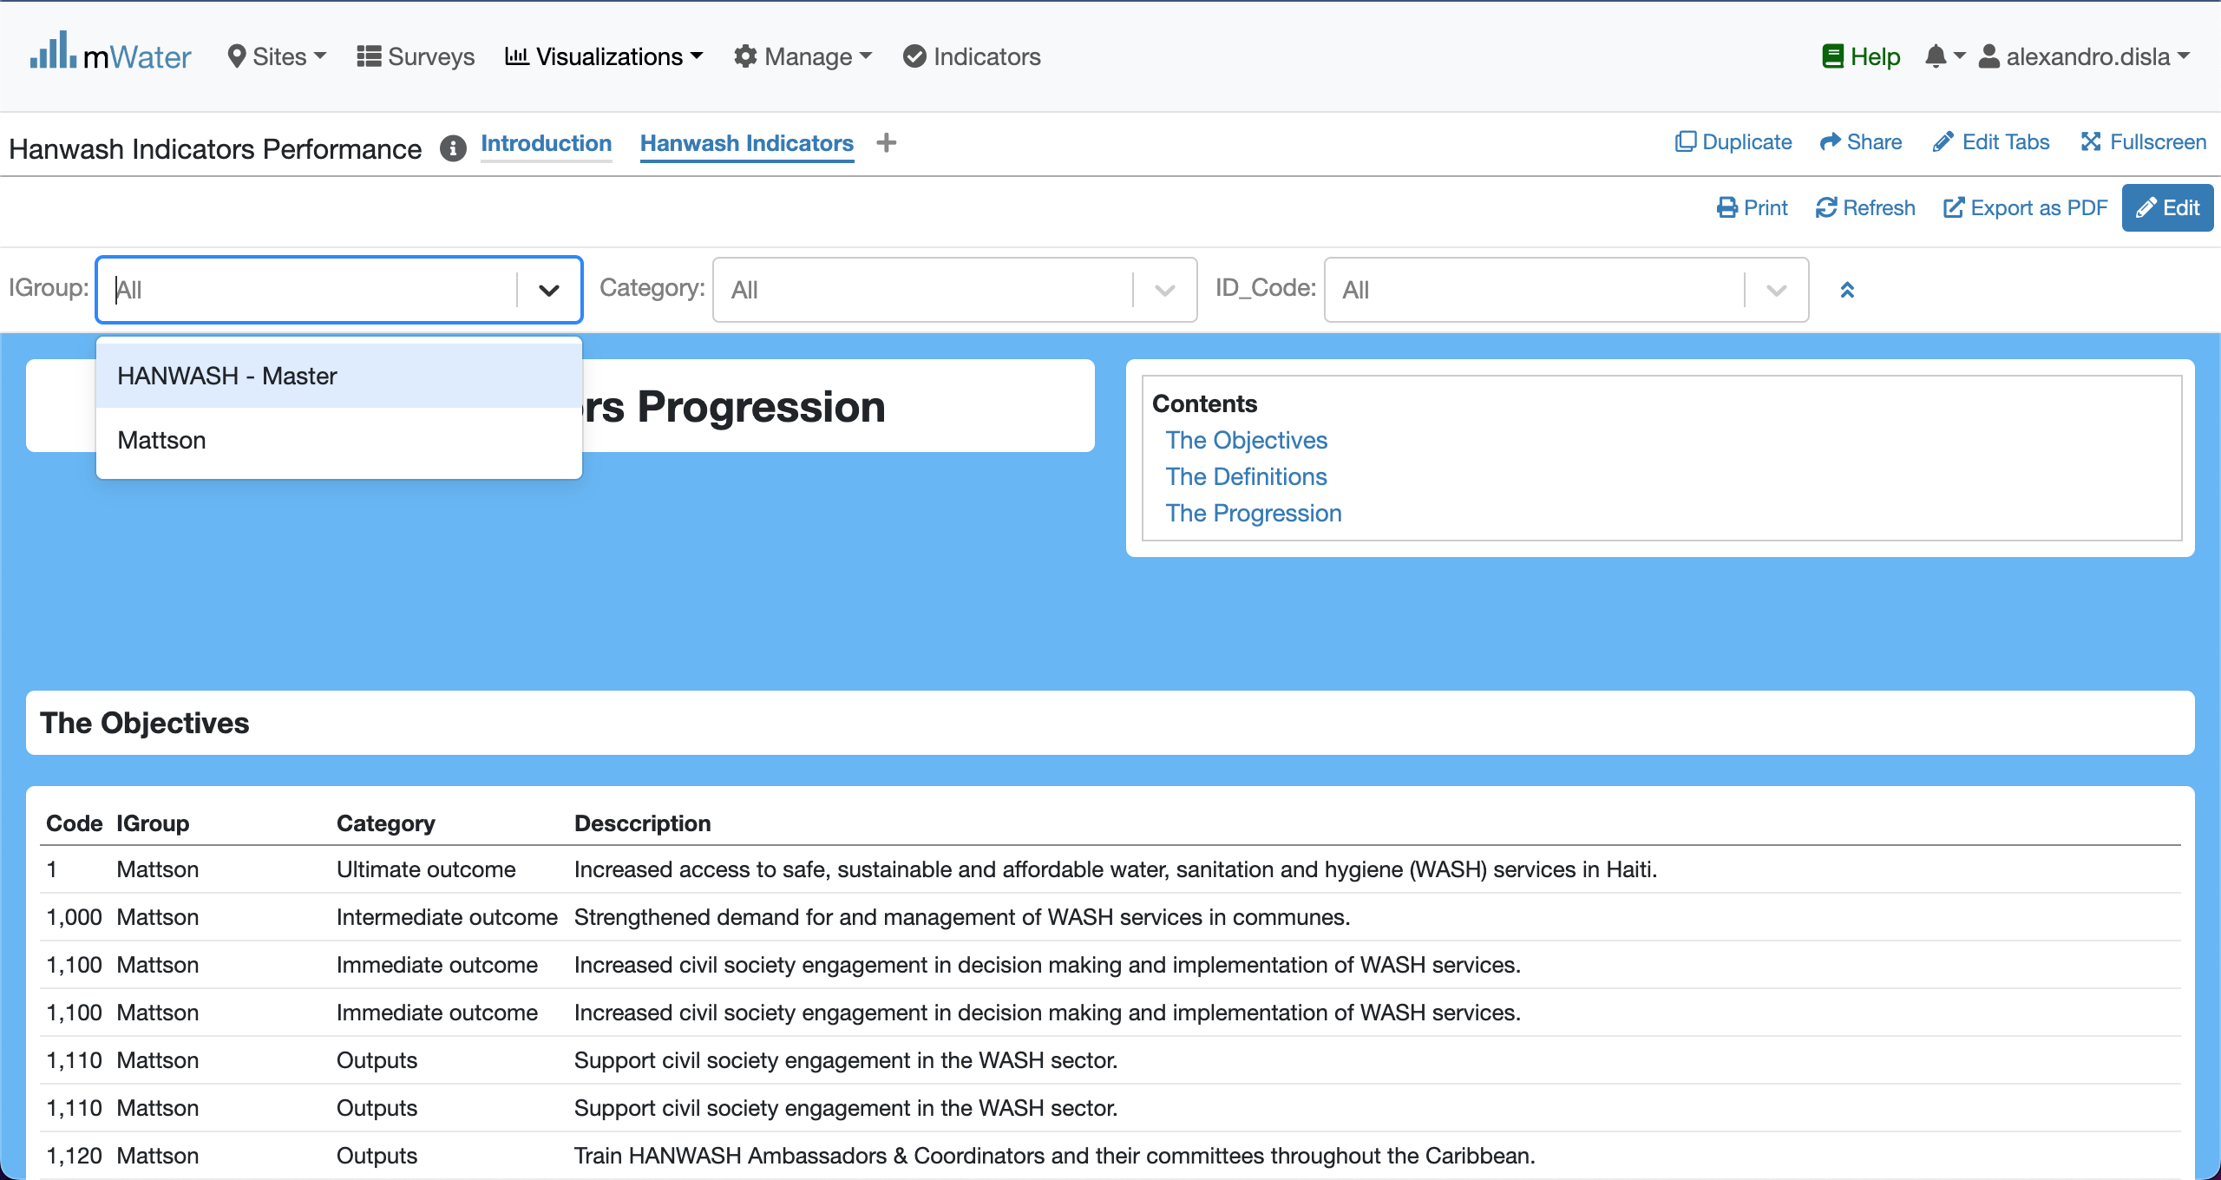
Display the quickfilters
Indicate the group classification tied to the indicators.

Slide 16
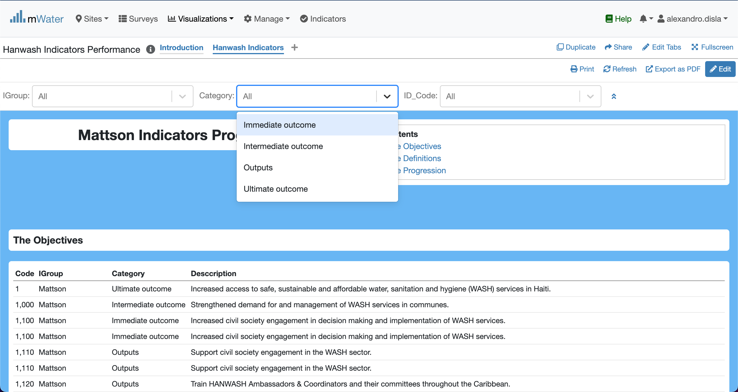
Display the quickfilters
The second level of the classification towards the indicators.

Slide 17
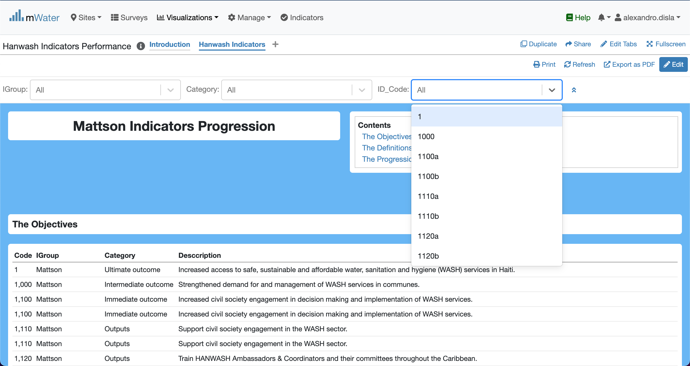
Display the quickfilters
The last layer of classification to completely ID the pair (category, indicator)

Slide 18
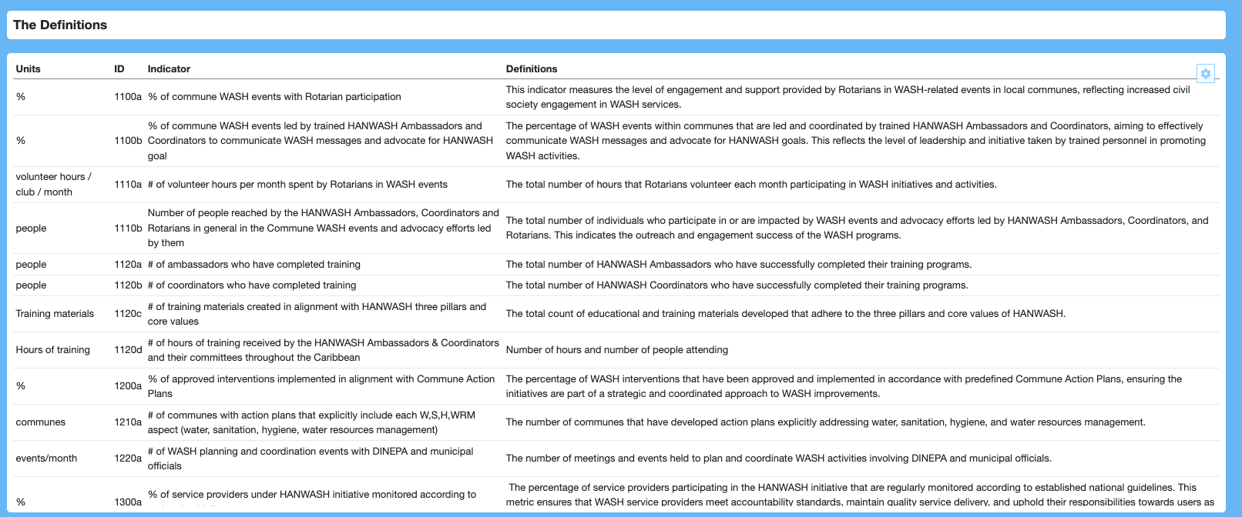
The indicator table
The units column to specify the unit of the indicator. The ID is under the complete control of the ID_code quick filter.
The indicators and their definition

Slide 19
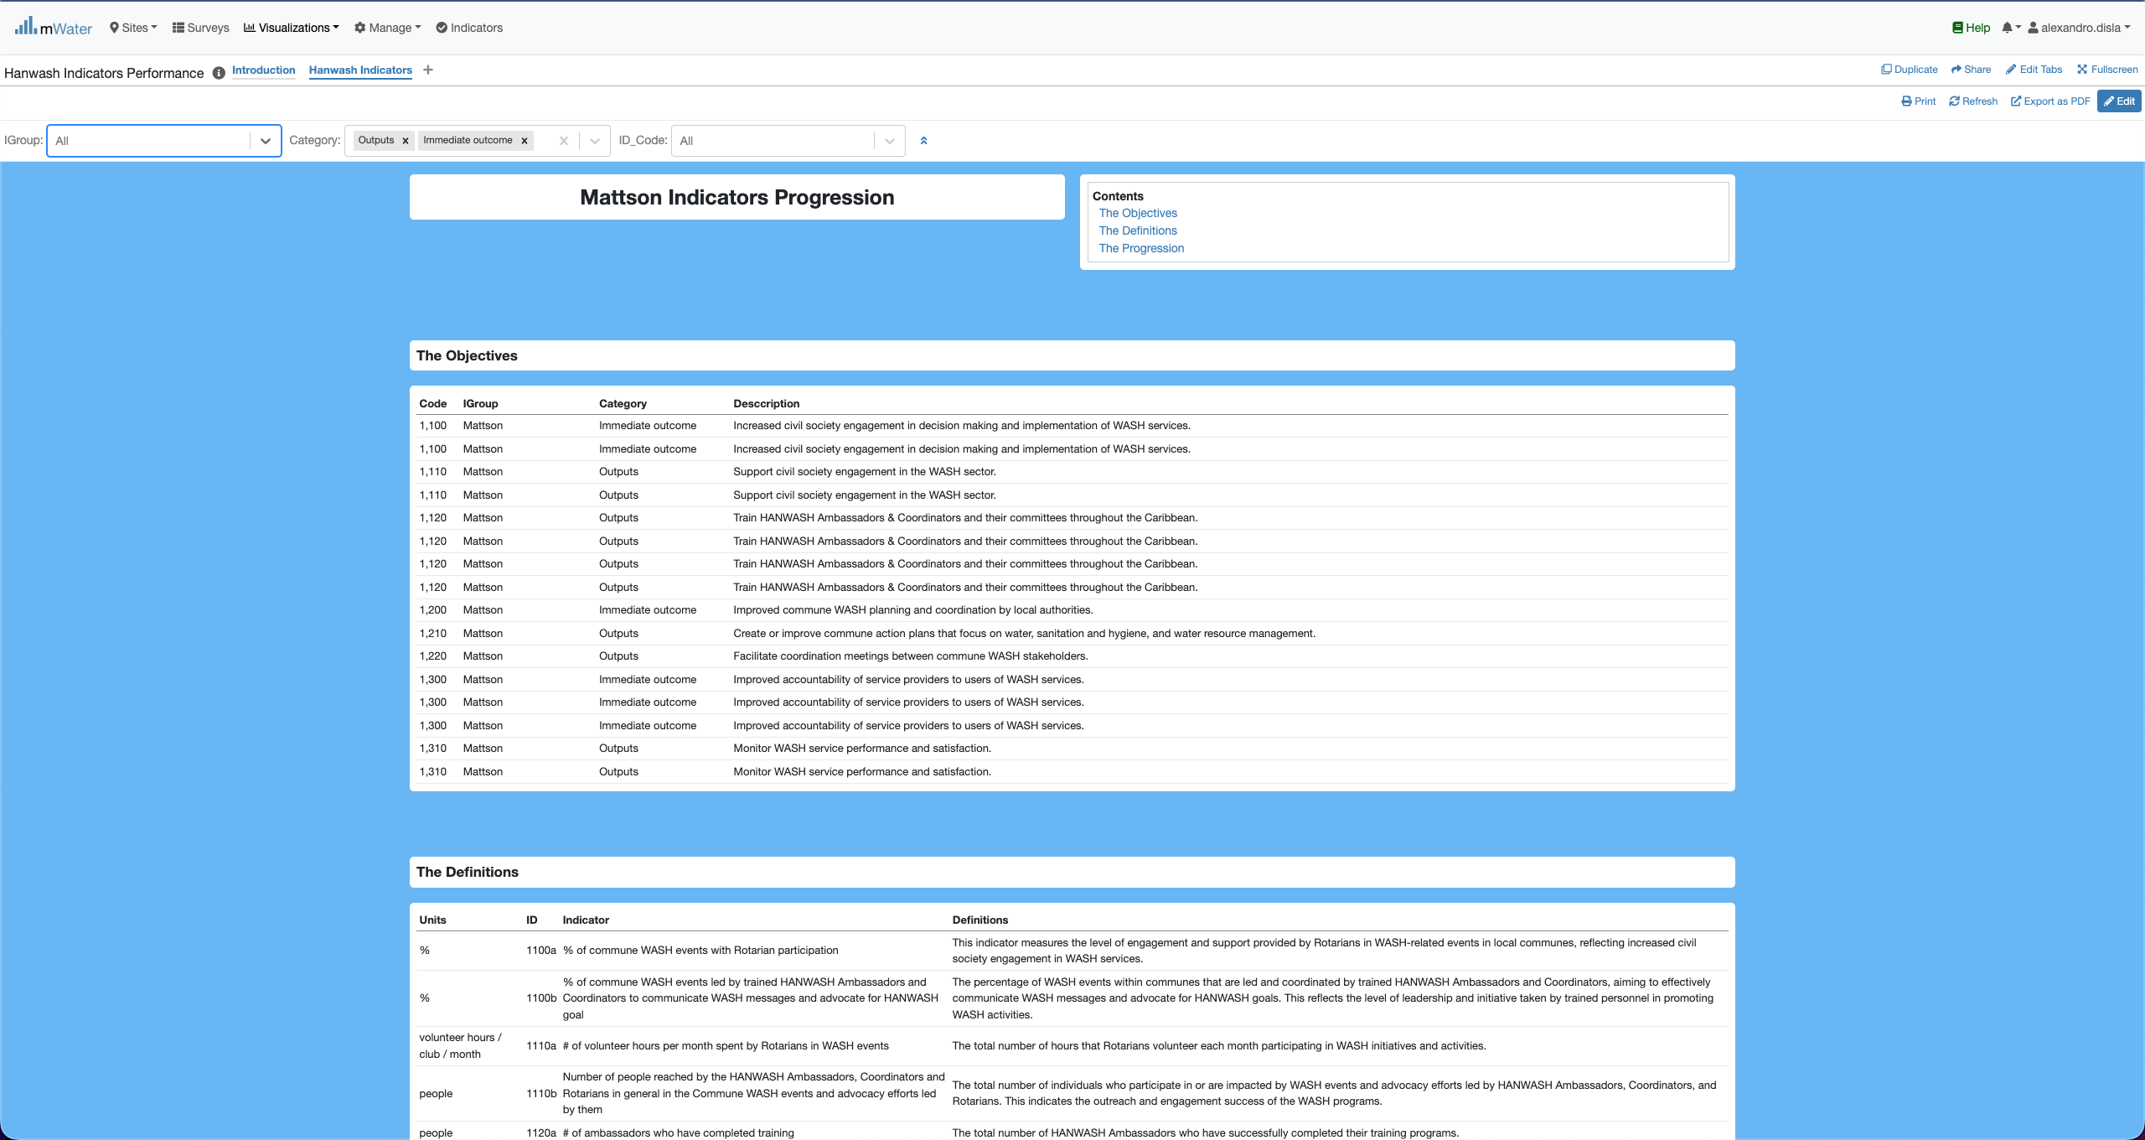
Category quickfilter effect
By design the category quick filter will allow you to select different categories and the section will behave to display the objectives, the definitions and the progression tables.

Slide 20
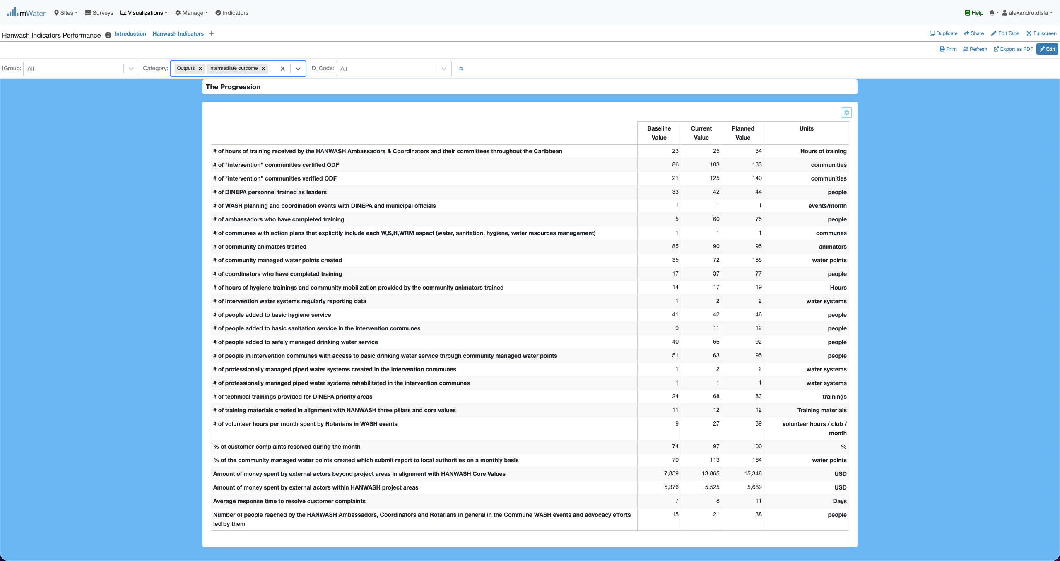
Category quickfilter effect
The values from the baseline to the planned value. The units are indicated. For the purpose of the presentation the data are generated.
The Indicator are show based on the category selected.

Slide 21
ID_Code quickfilter effect

